Slide 1
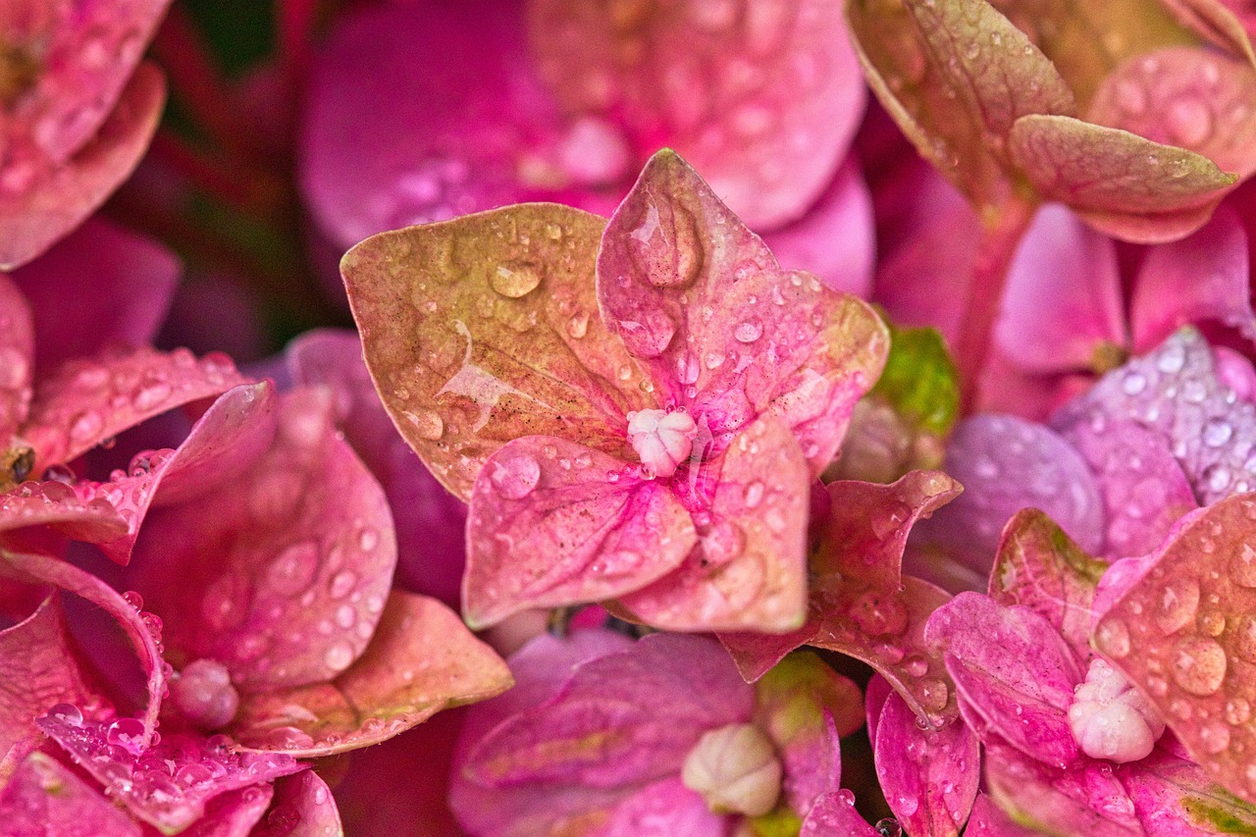
Flower Recognition
Rimple Poonia Dabas Sweta Joshi Sakshi Dalal

Slide 2
Google Images: Web scraping (Selenium and Chrome driver).
Flickr: API (good API call limit 3600 queries per hour), used flickrapi python package.
Pixabay: API (100 requests per minute limit)
Data Collection:
Bougainvillea
Daffodil
Dahlia
Foxglove
Hibiscus
Hydrangea
Orchid
Rose
Sunflower
Tulip

Slide 3
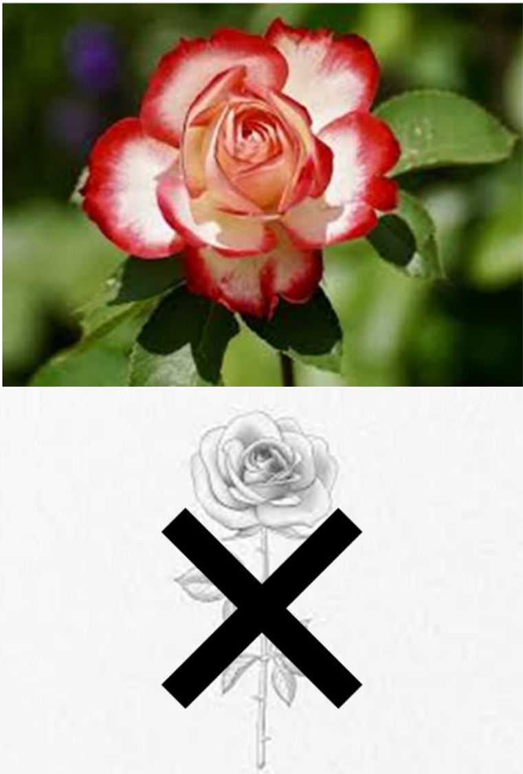
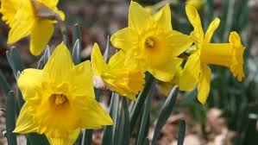
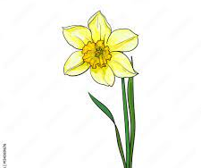

Data Cleaning

Slide 4

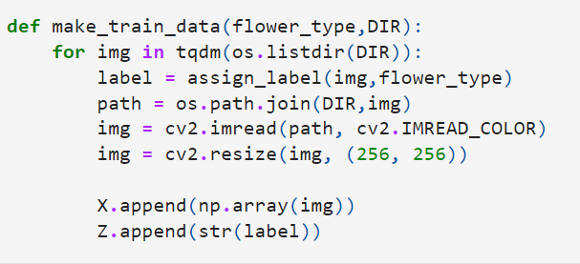
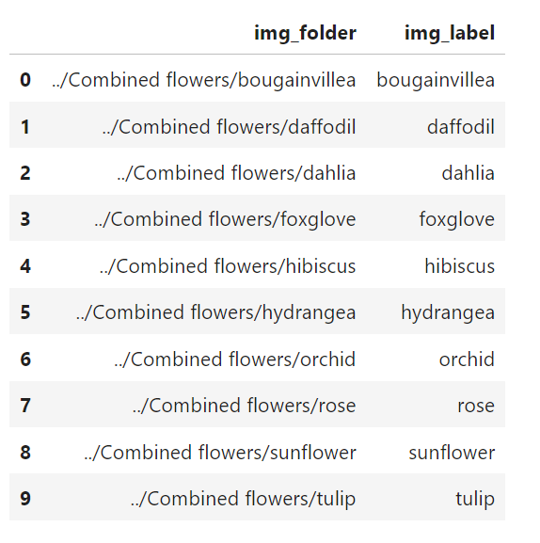
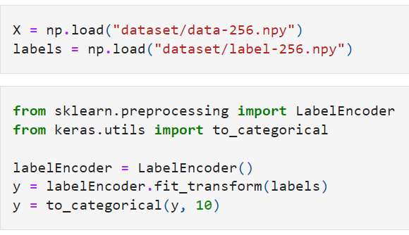
Labeling
Saving as .npy
Resizing
Rescaling
Data preprocessing

Slide 5
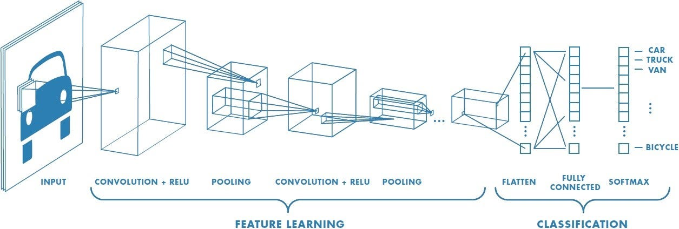
Model Architecture: Convolutional Neural Network
Image source : https://www.interviewbit.com/blog/cnn-architecture/

Slide 6
Model Comparison
Batch Size | Epoch | Parameters | Accuracy
32 | 50 | 9,599,882 | 60
64 | 70 | 4,146,314 | 74
64 | 70 | 3,393,770 | 76
64 | 80 | 4,146,314 | 79

Slide 7
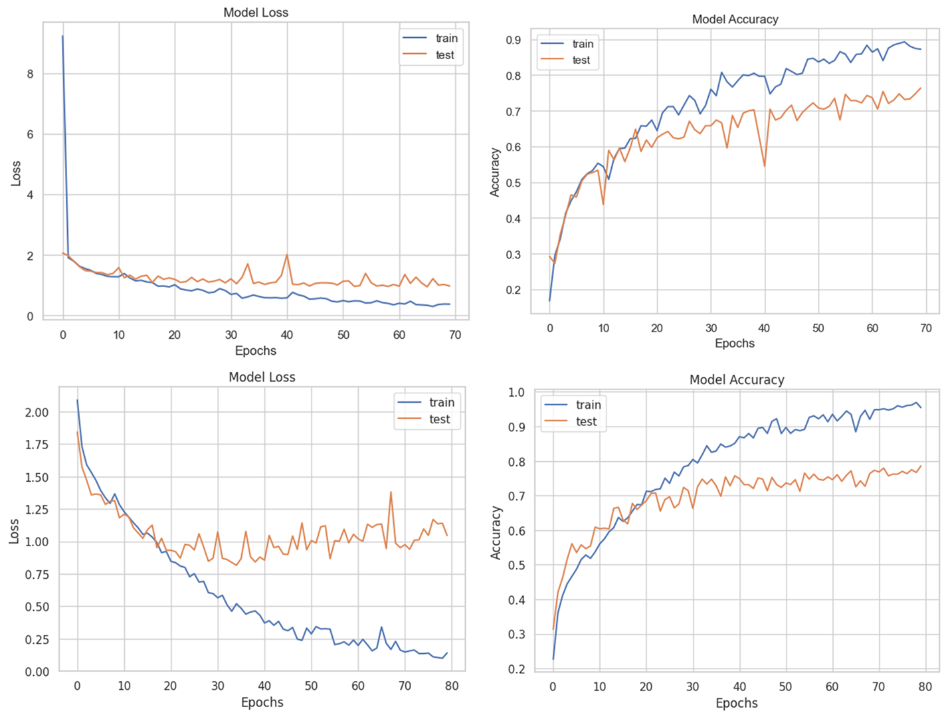
Accuracy : 76
Accuracy : 79

Slide 8
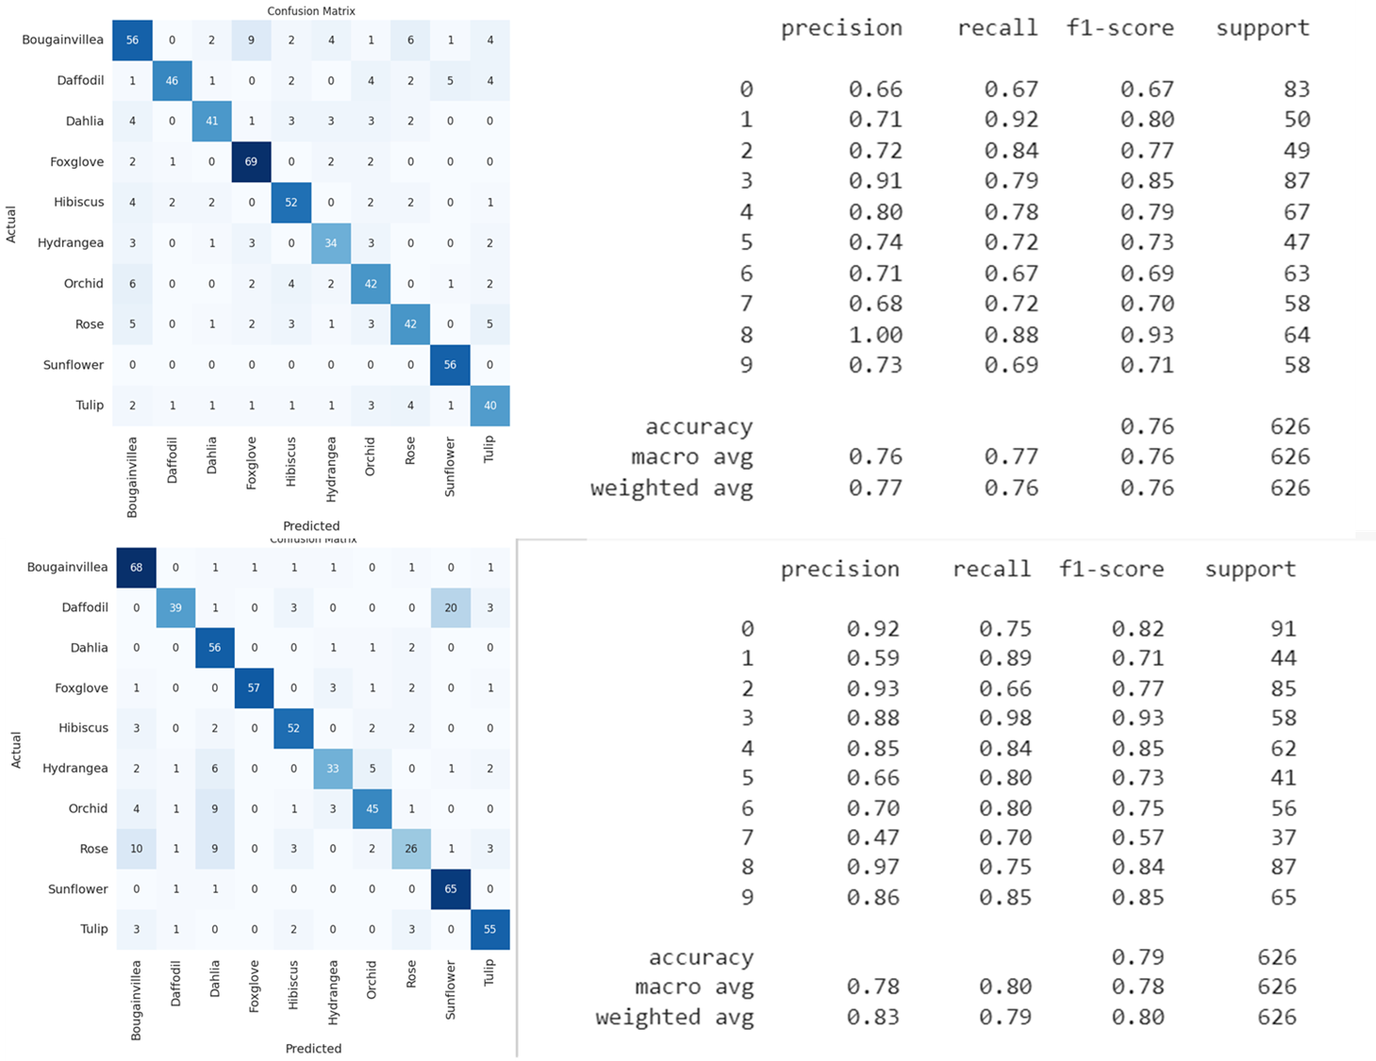
Accuracy : 76
Accuracy : 79

Slide 9
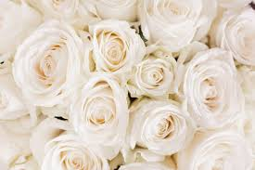
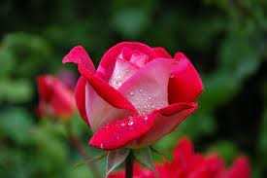
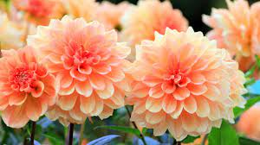
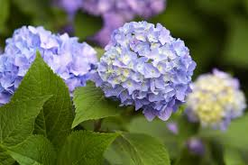
Actual : Rose
Predicted: Orchid
Actual : Rose
Predicted : Rose
Actual : Dahlia
Predicted : Tulip
Actual : Hydrangea
Predicted : Hydrangea

Slide 10
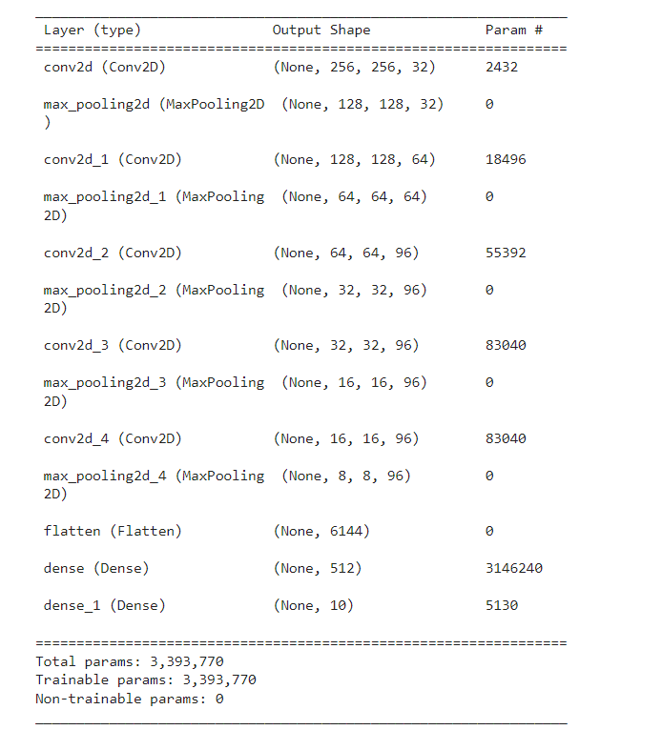
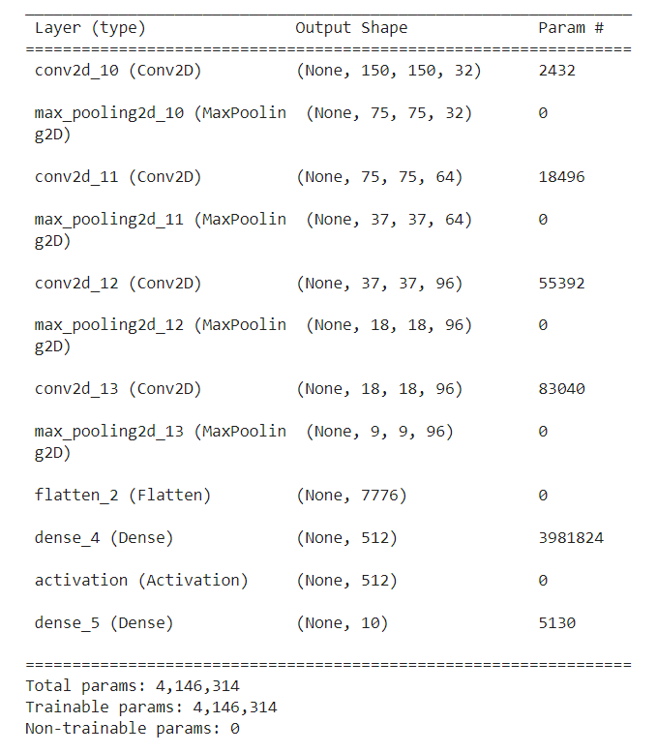
Accuracy : 76
Accuracy : 79

Slide 11
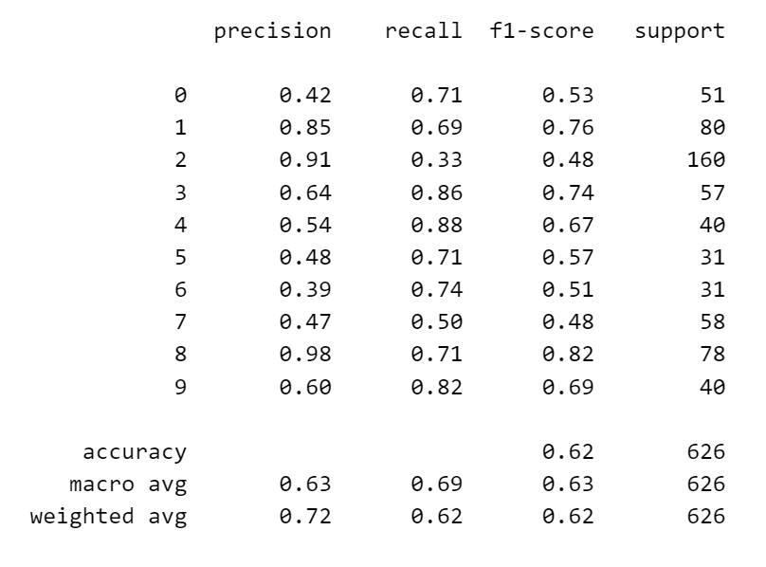
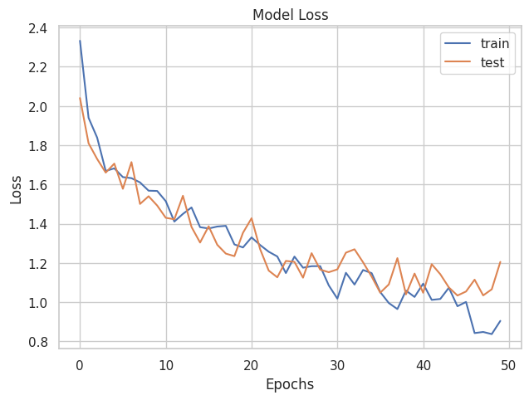
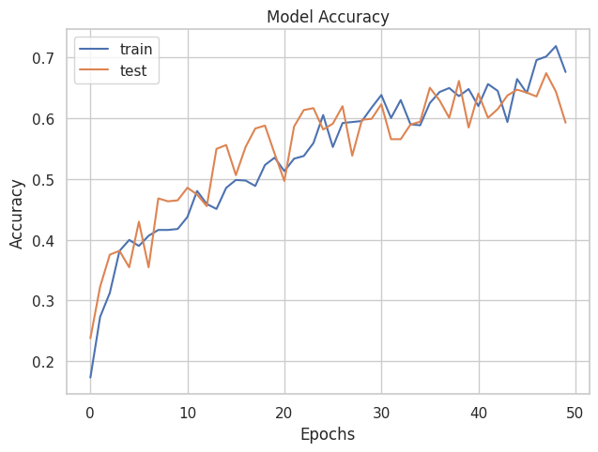
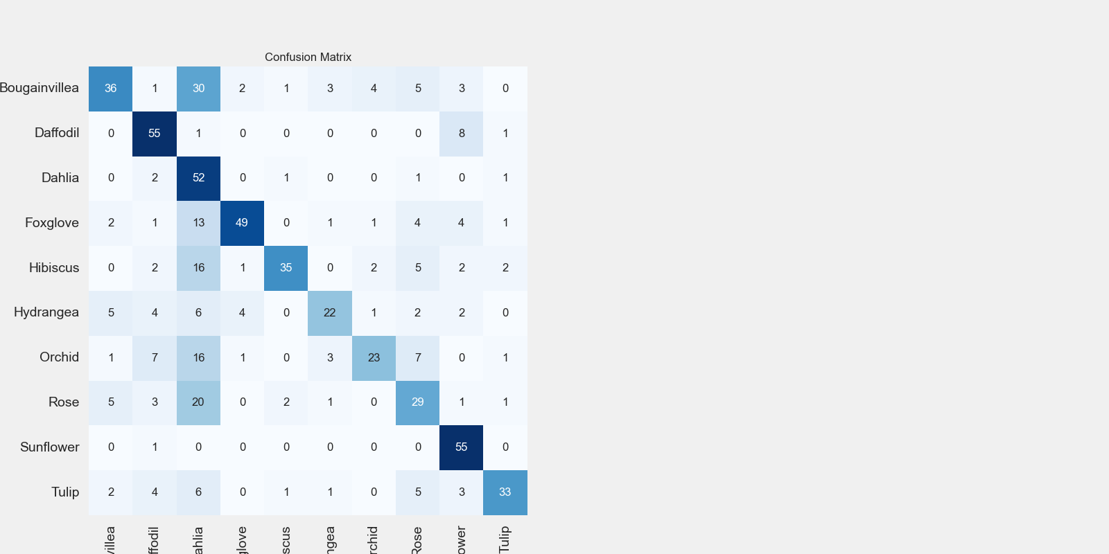
For Accuracy 62

Slide 12
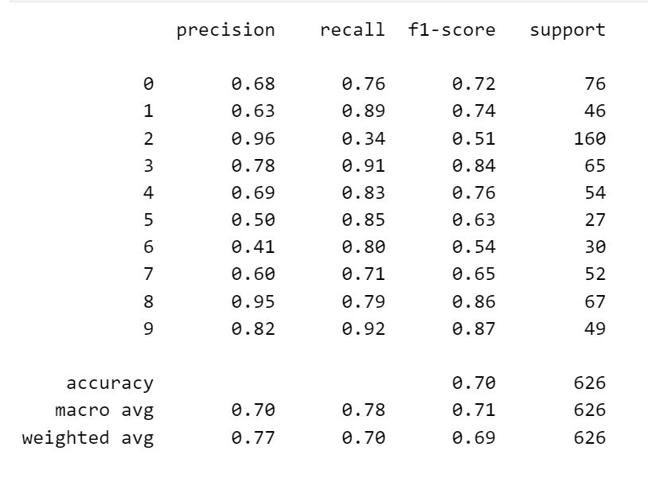
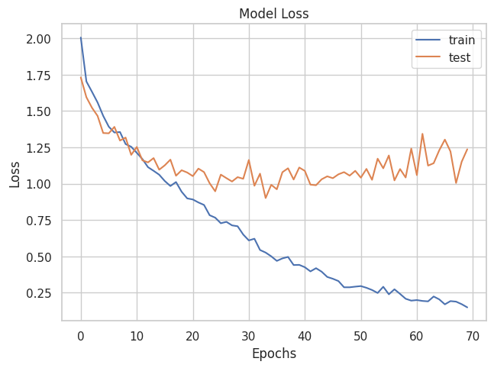
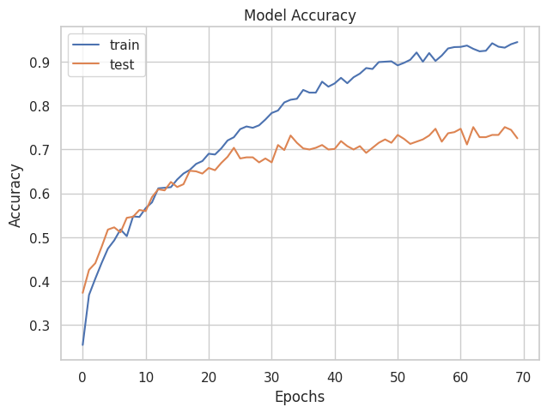
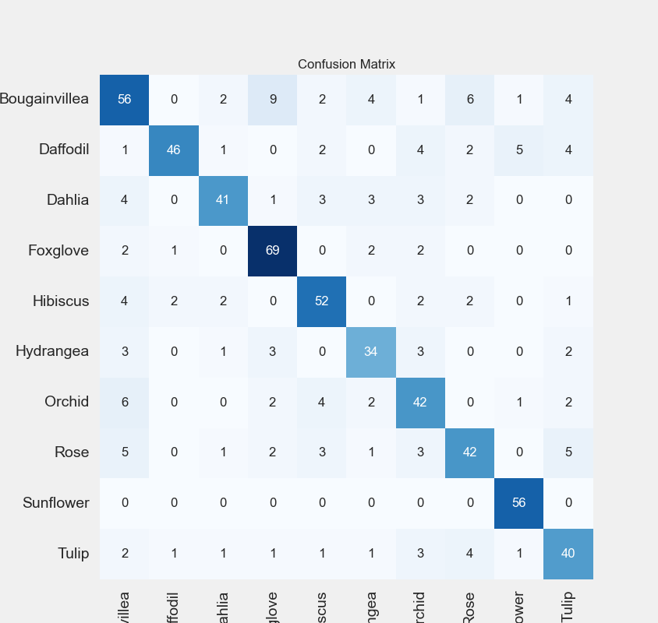
For Accuracy 70

Slide 13
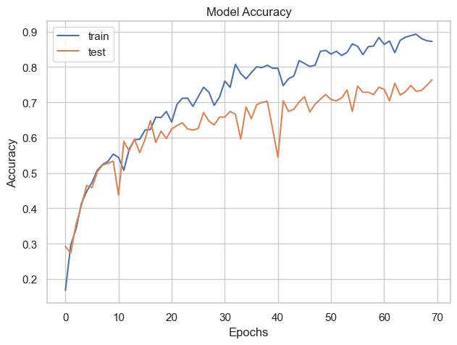
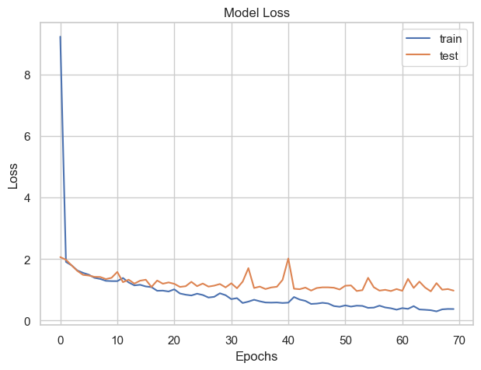
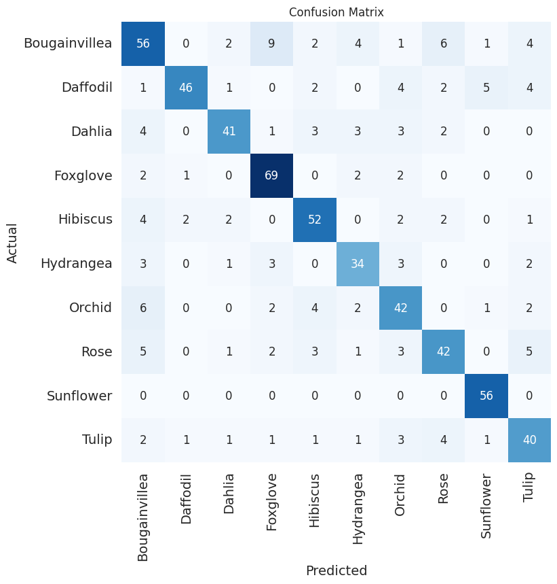
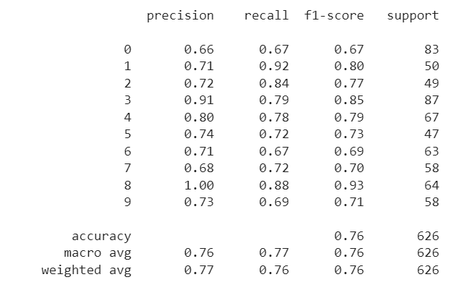
For Accuracy 76

Slide 14
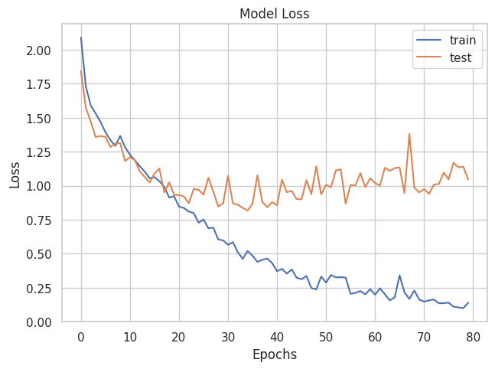
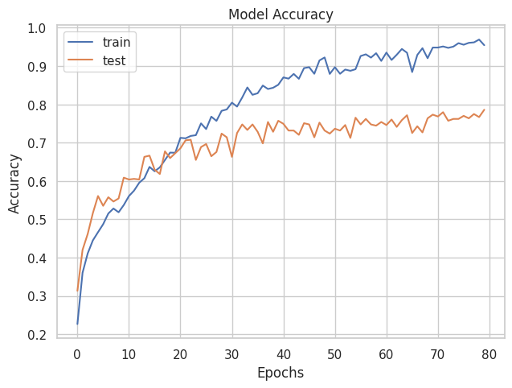
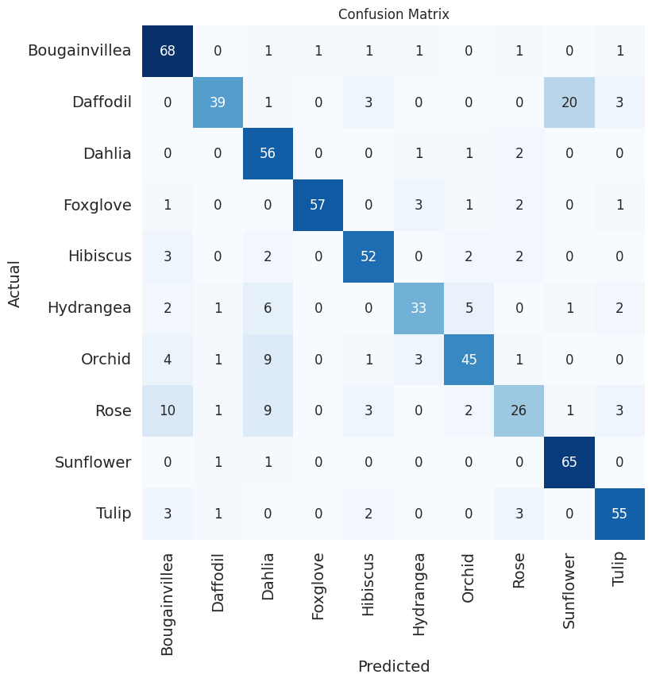
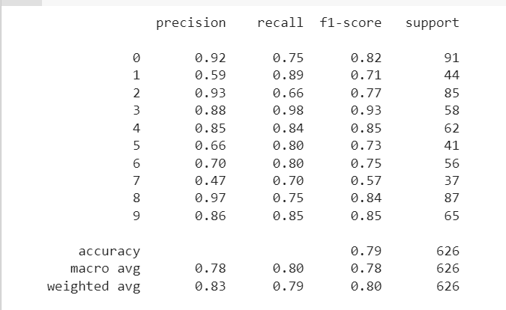
For Accuracy 79

